Slide 1
EFFECTIVE PRESENTATION SKILLS
Fouzia Goreja
Assistant Professor(NUML)

Slide 2
DEFINITION
A presentation is a means of communication which can be adapted to various speaking situations, such as talking to a group, addressing a meeting or briefing a team.
Following steps are included in preparing effective presentation:
4 Ps
Plan
Prepare
Practice
Present

Slide 3
PLANNING
Planning usually include following questions:
Who is your audience?
Why are they there?
What is your goal?
How long will it be?
Where will it take place?

Slide 4


Slide 5
PREPARATION
Following points must be kept in mind while preparing:
Structure
Prompt
Visual aids
Voice
Appearance
Style
Questions

Slide 6
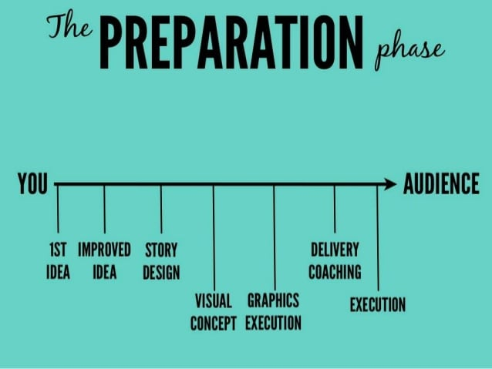

Slide 7
STRUCTURE OF PRESENTATION
Write your presentation in this order:
Objective
Beginning or introduction Grab the audience attention
Main content: Main theme content should be relevant to topic
Summary /Conclusion Key message
Recommendations
Questions

Slide 8
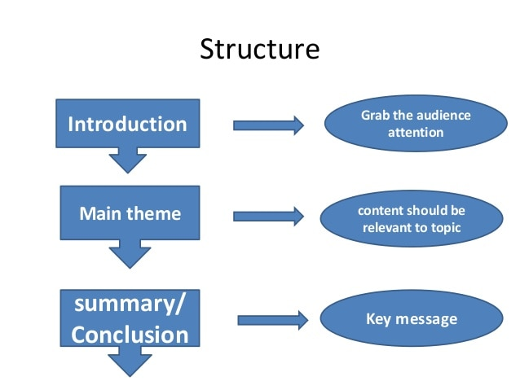

Slide 9
PROMPT
Short bullet points, key words only.
Put your entire prompt onto your power point slides.
These prompt are for you.

Slide 10
VISUAL AIDS
Use simple fonts, colors and graphs.
Use images and clipart. 3 to 7 bullets per slide.
Don’t over crowd your slides, it will not look professional.
New or different visual aids wake people up.

Slide 11
VOICE
Louder and clear than your normal pitch.
Vary pitch and volume.
Over emphasis

Slide 12
APPEARANCE
Dark colors read as businesslike.
Wear comfortable shoes to weight your feet evenly.
Allow yourself to move a bit.
Look confident.
Professional dress code
Style : You already have a style don’t try to copy others.
Use words and sentences you use in normal days.
Be yourself.

Slide 13
QUESTIONS
Sketch an idea that what kind of questions audience may ask

Slide 14
PREPARATION MATERIAL
You can use following items to make the content of your presentation:
Handouts
Personal notes
Internet
Visual aids

Slide 15
Practice
Rehearse all points what you prepare.
Rehearse with all visual aids and handouts.
Practice again and again to manage time.
Rehearse in front of mirror or a friend

Slide 16
Present
Make a strong start.
Engage the audience in first 2-3 minutes.
Show your passion through your movements and gestures.
Make an eye contact.
Don’t forget to smile as well, unless your topic is very grim

Slide 17


Slide 18
FLAWS IN PRESENTATION
Lack of experience.
Lack of enthusiasm.
Lack of practice.
Lack of related material.
Lack of confidence.
Hesitation.
Ambiguity in the results that you want to conclude.

Slide 19
FACTORS FOR SUCCESSFUL PRESENTATION
Be over prepared.
Rehearse and practice.
Grip on your topic.
Know your subject.
Be positive.
Avoid stress.

Slide 20
CONCLUSION
Always prepare
Channelize your fear
Interact with your audience

